Slide 1

https://runtimeverification.com
runtime
verification
Technology and Products
Grigore Rosu
Founder, President and CEO
Professor of Computer Science, University of Illinois

Slide 2
Overview
Runtime Verification
  Company
    Licensed by University of Illinois at Urbana-Champaign
  Scientific Field
    Co-pioneered with NASA colleagues and collaborators
Products and Demos
  RV-Match
  RV-Predict
  RV-Monitor
Conclusion

Slide 3
Runtime Verification, Inc.
The Company

Slide 4
Description of Company
Runtime Verification, Inc. (RV): startup company aimed at bringing the best ideas and technology developed by the runtime verification community to the real world as mature and competitive products; licensed by the University of Illinois at Urbana-Champaign (UIUC), USA.
Mission: To offer the best possible solutions for reliable software development and analysis.

Slide 5
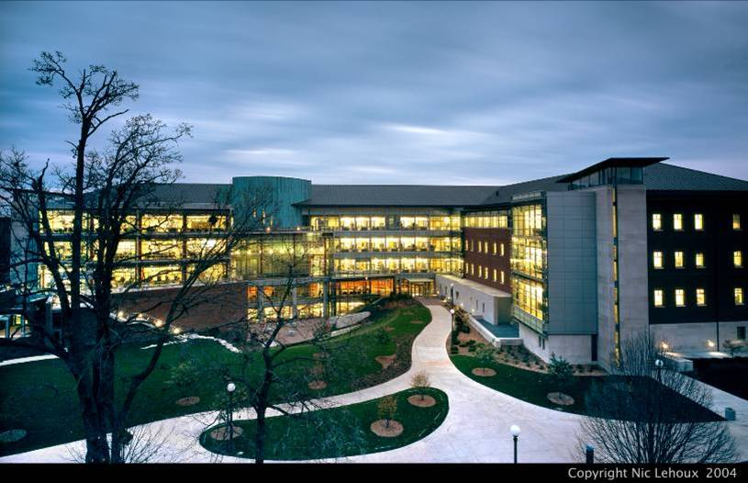
Computer Science @ UIUC
Ranked top 5 in USA (US News)
#1 in USA in Soft. Eng. (csrankings.org)
RV technology is licensed by UIUC
RV employees are former UIUC students

Slide 6
Technology
Runtime verification is a new field aimed at verifying computing systems as they execute
  Good scalability, rigorous, no false alarms
We are leaders in the field
  Coined the term “runtime verification”
    As a NASA research scientist, back in 2001
  Founded the Runtime Verification conference (RV)
  100+ publications
  Raised $7M+ funding to develop technology

Slide 7
Runtime Verification
The Field

Slide 8
What is Runtime Verification (RV)?
Subfield of program analysis and verification
  So is static analysis (SA)
  SA and RV complement each other
Main idea of RV is different from that of SA:
  Execute program to analyze
    Using instrumentation or in a special runtime environment
  Observe execution trace
  Build model from execution trace
  Analyze model
  Steps above may be combined (e.g., online analysis)

Slide 9
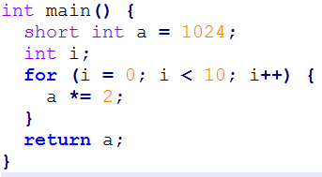
Recall Static Analysis
(including model-checking)
Code
Model
Bug 1
Bug2
…
Extract
Analyze
Advantages:
+ good code coverage
+ early in development
+ mature field
Limitations:
- undecidable problem, so
- false positives/negatives or
- does not scale

Slide 10
Runtime Verification
Event Trace
Highly customized for property of interest
Highly customized for property of interest
Code
Build
Execute
Model
Bug 1
Bug2
…
Analyze
Advantages:
+ precise (no false alarms)
+ good scalability and rigor
+ recovery possible
Limitations:
- code must be executable
- less code coverage

Slide 11
Addressing the Limitations
Code must be executable
  Use complementary, static analysis, earlier in process
  Use symbolic execution (RV-Match)
Less code coverage
  Integrate RV tools with your existing testing infrastructure: your unit tests should already provide good code coverage; invoke RV tools on each test
  Systematic re-execution: cover new code each time
  Symbolic execution covers many inputs at once

Slide 12
Runtime Verification
The Products

Slide 13



Runtime Verification Products https://runtimeverification.com
RV-Match is a semantics-based automatic debugger
for common and subtle C errors, and an automatic
dynamic checker for all types of ISO C11 undefinedness.
- C (mature); Java and JavaScript (prototypes)
RV-Predict is an automatic dynamic data-race detector
for Java, which is sound (no false positives) and maximal
(no other sound dynamic tool can find more races).
- Java (mature), C/C++ with interrupts (prototype)
RV-Monitor is a runtime monitoring tool that
allows for checking and enforcement of safety
properties over the execution of your software.
- Java (prototype), C/C++ (prototype)

Slide 14
Runtime Verification Products
Coverage vs. Performance vs. Expressiveness
Big triangle: all
runtime behaviors
of your program
One path only;
0-100% overhead; complex properties
From one path to complete coverage / verification; any properties; may require user input
Maximal number of causally equivalent paths predicted from one path;
1-10²x overhead;
races, atomicity, deadlocks

Slide 15
RV-Match
Semantics-based runtime verification

Slide 16
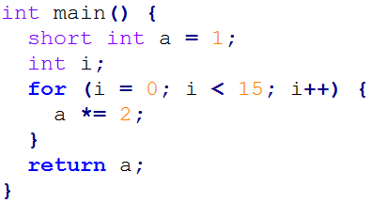
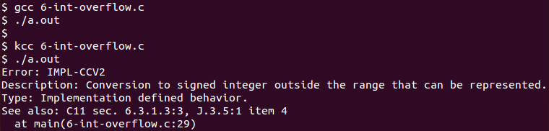
RV-Match Overview
Code (6-int-overflow.c)
Get to market faster, increase code portability, and save on development and debugging with the most advanced and precise semantics-based bug finding tool. RV-Match gives you:
an automatic debugger for subtle bugs other tools can't find, with no false positives
seamless integration with unit tests, build infrastructure, and continuous integration
a platform for analyzing programs, boosting standards compliance and assurance
…
Conventional compilers do not detect problem
RV-Match’s kcc tool precisely detects and reports error, and points to ISO C11 standard

Slide 17
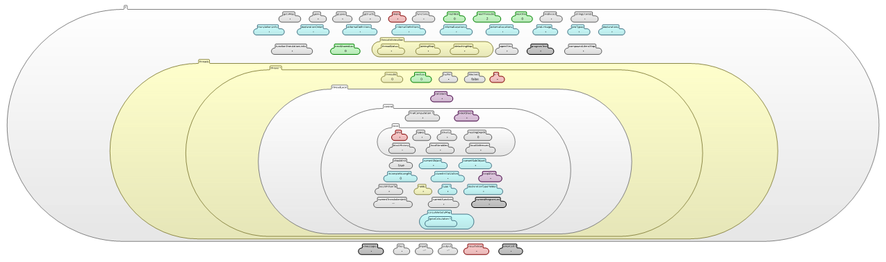
RV-Match Approach
Execute program within precise mathematical model of ISO C11
Build abstract program state model during execution
Analyze each event, performing consistency checks on state
Event Trace
Are all ISO C11
rules matched?
If “no” then error
Code
Build
Execute
Abstract State Model
Analyze
Heap
About 120 semantic state components

Slide 18
RV-Match: Bigger Picture
Test-case generation
Parser
Deductive program verifier
Interpreter
Formal Language Definition
(Syntax and Semantics)
C, C++, Java, JavaScript, etc.
Model checker
Compiler
Symbolic execution
(semantic) Debugger
Notes:
RV-Match is a programming language analysis and design framework.
Its vision is to allow and encourage the language designers to formally define their languages once and for all, using an intuitive and attractive notation, and then obtain essentially for free implementations as well as analysis tools for the defined languages.
We currently focus on the interpretation capability only, which in combination with the C language definition yields a powerful undefinedness checker.

Slide 19
Formal Language Definitions
To define programming languages formally, we use the academic K tool and notation
  http://kframework.org
  Developed in the Formal Systems Laboratory (my research group) at the University of Illinois
  Open source

Slide 20
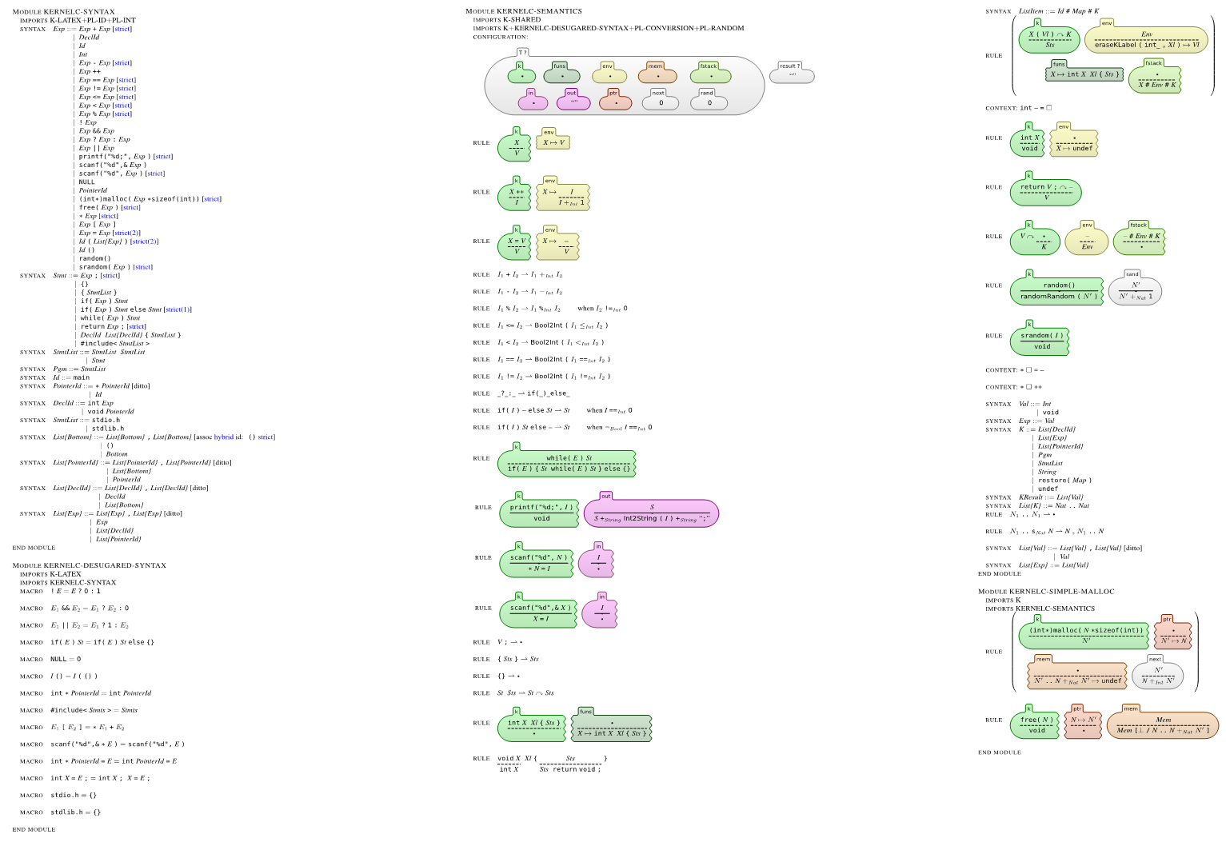
Complete K Definition of KernelC
Notes:
Here is a complete definition of a fragment of C, called KernelC, as generated by the K tool.
The left column defines its formal syntax and the other two its formal semantics.
I will next zoom through this definition and highlight some of the K tool’s features.

Slide 21
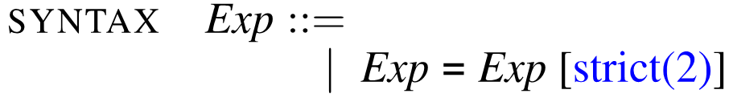
Complete K Definition of KernelC
Syntax declared using annotated BNF
Notes:
Here is a complete definition of a fragment of C, called KernelC, as generated by the K tool.
The left column defines its formal syntax and the other two its formal semantics.
I will next zoom through this definition and highlight some of the K tool’s features.

Slide 22
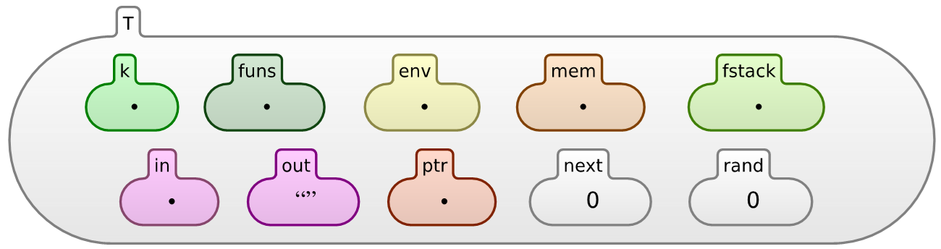
Complete K Definition of KernelC
Configuration given as a nested cell structure.
Leaves can be sets, multisets, lists, maps, or syntax
Notes:
Here is a complete definition of a fragment of C, called KernelC, as generated by the K tool.
The left column defines its formal syntax and the other two its formal semantics.
I will next zoom through this definition and highlight some of the K tool’s features.

Slide 23
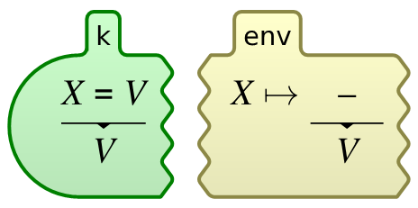
Complete K Definition of KernelC
Semantic rules given contextually
rule
<k> X = V => V …</k>
<env>… X |-> (_ => V) …</env>
Notes:
Here is a complete definition of a fragment of C, called KernelC, as generated by the K tool.
The left column defines its formal syntax and the other two its formal semantics.
I will next zoom through this definition and highlight some of the K tool’s features.

Slide 24
K Scales
Several large languages were recently defined in K:
Java 1.4: by Bogdanas etal [POPL’15]
  800+ program test suite that covers the semantics
JavaScript ES5: by Park etal [PLDI’15]
  Passes existing conformance test suite (2872 pgms)
  Found (confirmed) bugs in Chrome, IE, Firefox, Safari
C11: Ellison etal [POPL’12, PLDI’15]
  It defines the ISO C11 standard
  Including all undefined behaviors
…
Notes:
K scales!
Besides a series of smaller and paradigmatic languages that are used for teaching purposes, there are several large and real languages that have been given semantics in K, such as:
Java has been defined by Bogdanas;
Javascript by Park and Stefanescu;
C by Ellison etal;
just to mention a few.
Many other large K semantics are under development.

Slide 25
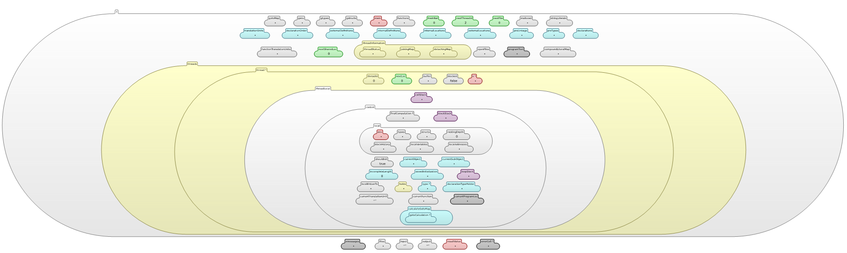
K Configuration and Definition of C
Heap
… plus ~3000 rules …
120 Cells!
Notes:
To give an idea what it takes to define a large language, here is, for example, the configuration of C.
It has more than 120 cells!
The heap, which is the subject of so many debates in program verification, is just one of them.

Slide 26
Advantages of RV-Match Approach
No need to re-implement tools as language changes
  Easy to customize tools
    E.g., embedded C for a specific micro-controller
  Programming languages continuously evolve (C90 → C99 → C11 → …; or Java 1.4 → Java 5 → … → Java 8 → …)
Tools are correct by construction
  Tools are language-independent and can produce correctness certificates based on language semantics only
  Language definitions are open-source and public
    Experts worldwide can “validate” them
    No developer “interpretation” of language meaning (e.g., C)

Slide 27
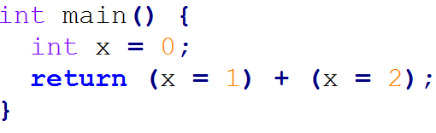
Does it Work?
Let’s use RV-Match with (extended) C11 semantics
Goal: catch undefined behavior!
  You should always avoid undefined behavior in your code!!!
  Undefined behavior → lack of portability, security risks, non-determinism
Wrapped RV-Match[C11] as an ICO C11 compliant drop-in replacement of C compilers (e.g., gcc), called kcc
Example: what does the following return?
4 with gcc
3 with clang (LLVM)
ISO C11: undefined!
kcc reports error

Slide 28
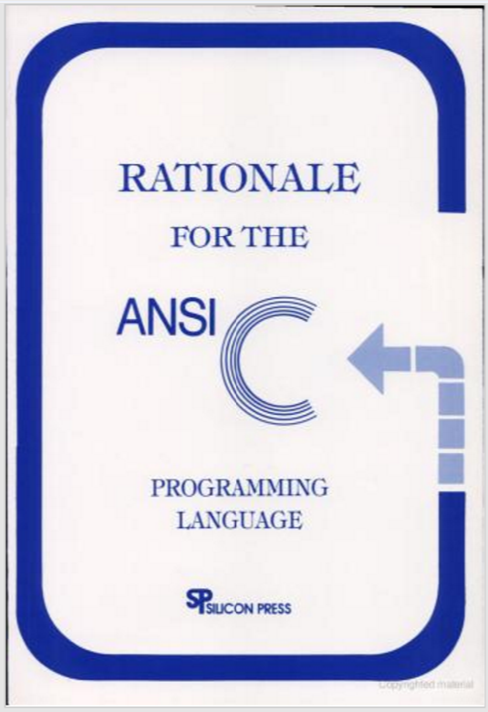
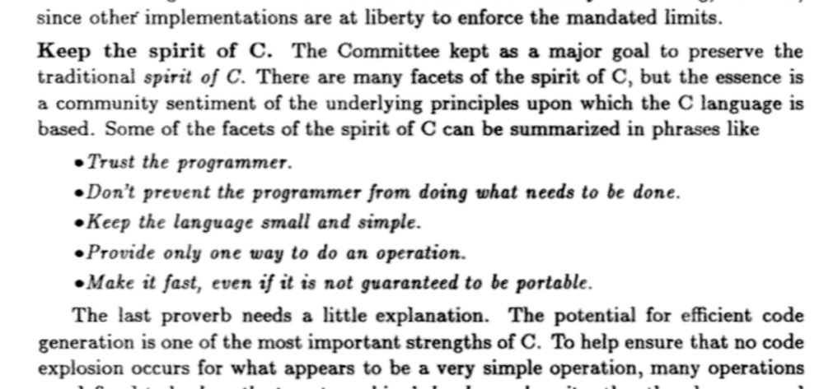
Why Undefined Behavior Matters?
And, because of that, your code tested on PC will not port on embedded platform, will crush when you change compiler, and will give you different results with even the same compiler but different options …
{

Slide 29
RV-Match DEMO
Go to https://runtimeverification.com/match to download RV-Match (currently only C11 version available); kcc and then execute the C programs under examples/demo in the given order
  Most of the examples above are also discussed, with detailed comments, at
  https://runtimeverification.com/match/docs/runningexamples
You can also run the Toyota ITC benchmark: https://runtimeverification.com/match/docs/benchmark

Slide 30
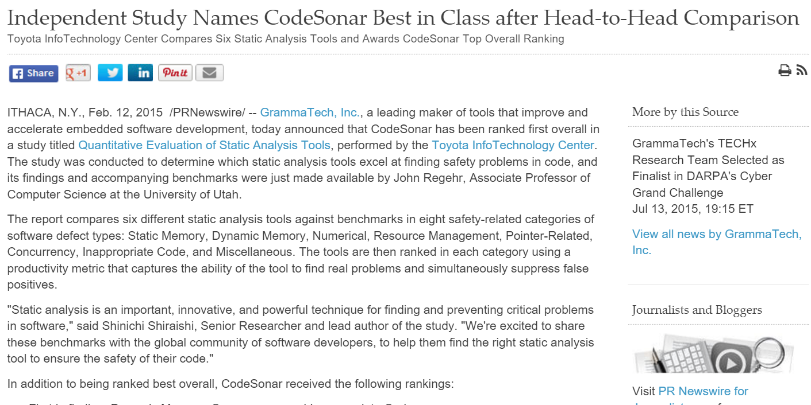
Does it Really Work?
Let’s Evaluate it!
Evaluated RV-Match on the Toyota ITC benchmark, aimed at quantitatively evaluating static analysis tools
  By Shin’ichi Shiraishi and collaborators
  ISSRE’14 original paper, compared six tools; paper disappeared (!)
  Press release by Grammatech, available at PRNewswire :
… report compares six different static analysis tools against benchmarks in eight safety-related categories of software defect types: Static Memory, Dynamic Memory, Numerical, Resource Management, Pointer-Related, Concurrency, …

Slide 31
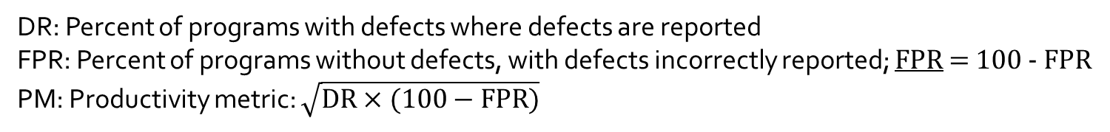
Toyota ITC Benchmark Paper
- Static Analysis Tools -
Shiraishi etal published revised version in ISSRE 2015
1276 programs; 3 static analysis tools compared
Grammatech CodeSonar wins again (numbers below from ISSRE’15 paper)
Shiraishi et al., ISSRE ’15 | RV-Match |  |  | GrammaTech CodeSonar |  |  | MathWorks Code Prover |  |  | MathWorks Bug Finder |  |  | GCC |  |  | Clang
 |  |  |  | DR | FPR | PM | DR | FPR | PM | DR | FPR | PM | DR | FPR | PM | DR | FPR | PM
Static memory |  |  |  | 100 | 100 | 100 | 97 | 100 | 98 | 97 | 100 | 98 | 0 | 100 | 0 | 15 | 100 | 39
Dynamic memory |  |  |  | 89 | 100 | 94 | 92 | 95 | 93 | 90 | 100 | 95 | 0 | 100 | 0 | 0 | 100 | 0
Stack-related |  |  |  | 0 | 100 | 0 | 60 | 70 | 65 | 15 | 85 | 36 | 0 | 100 | 0 | 0 | 100 | 0
Numerical |  |  |  | 48 | 100 | 69 | 55 | 99 | 74 | 41 | 100 | 64 | 12 | 100 | 35 | 11 | 100 | 33
Resource management |  |  |  | 61 | 100 | 78 | 20 | 90 | 42 | 55 | 100 | 74 | 6 | 100 | 25 | 3 | 100 | 18
Pointer-related |  |  |  | 52 | 96 | 71 | 69 | 93 | 80 | 69 | 100 | 83 | 9 | 100 | 30 | 13 | 100 | 36
Concurrency |  |  |  | 70 | 77 | 73 | 0 | 100 | 0 | 0 | 100 | 0 | 0 | 100 | 0 | 0 | 100 | 0
Inappropriate code |  |  |  | 46 | 99 | 67 | 1 | 97 | 10 | 28 | 94 | 51 | 2 | 100 | 13 | 0 | 100 | 0
Miscellaneous |  |  |  | 69 | 100 | 83 | 83 | 100 | 91 | 69 | 100 | 83 | 11 | 100 | 34 | 11 | 100 | 34
AVERAGE (Unweighted) |  |  |  | 59 | 97 | 76 | 53 | 94 | 71 | 52 | 98 | 71 | 4 | 100 | 20 | 6 | 100 | 24
AVERAGE (Weighted) |  |  |  | 68 | 98 | 82 | 53 | 95 | 71 | 62 | 99 | 78 | 5 | 100 | 22 | 7 | 100 | 26
?
What you get for free
What you get for free
DR: Percent of programs with defects where defects are reported
FPR: Percent of programs without defects, with defects incorrectly reported; FPR = 100 - FPR
PM: Productivity metric: $\sqrt{DR×(100−FPR)}$

Slide 32
RV-Match on Toyota ITC Benchmark
- Comparison with Static Analysis Tools -
We do not have semantics for “inappropriate code” yet
We miss defects because inherent limited code coverage of RV
  No false positives for RV-Match!
Shiraishi et al., ISSRE ’15 | RV-Match |  |  | GrammaTech CodeSonar |  |  | MathWorks Code Prover |  |  | MathWorks Bug Finder |  |  | GCC |  |  | Clang
 | DR | FPR | PM | DR | FPR | PM | DR | FPR | PM | DR | FPR | PM | DR | FPR | PM | DR | FPR | PM
Static memory | 100 | 100 | 100 | 100 | 100 | 100 | 97 | 100 | 98 | 97 | 100 | 98 | 0 | 100 | 0 | 15 | 100 | 39
Dynamic memory | 94 | 100 | 97 | 89 | 100 | 94 | 92 | 95 | 93 | 90 | 100 | 95 | 0 | 100 | 0 | 0 | 100 | 0
Stack-related | 100 | 100 | 100 | 0 | 100 | 0 | 60 | 70 | 65 | 15 | 85 | 36 | 0 | 100 | 0 | 0 | 100 | 0
Numerical | 96 | 100 | 98 | 48 | 100 | 69 | 55 | 99 | 74 | 41 | 100 | 64 | 12 | 100 | 35 | 11 | 100 | 33
Resource management | 93 | 100 | 96 | 61 | 100 | 78 | 20 | 90 | 42 | 55 | 100 | 74 | 6 | 100 | 25 | 3 | 100 | 18
Pointer-related | 98 | 100 | 99 | 52 | 96 | 71 | 69 | 93 | 80 | 69 | 100 | 83 | 9 | 100 | 30 | 13 | 100 | 36
Concurrency | 67 | 100 | 82 | 70 | 77 | 73 | 0 | 100 | 0 | 0 | 100 | 0 | 0 | 100 | 0 | 0 | 100 | 0
Inappropriate code | 0 | 100 | 0 | 46 | 99 | 67 | 1 | 97 | 10 | 28 | 94 | 51 | 2 | 100 | 13 | 0 | 100 | 0
Miscellaneous | 63 | 100 | 79 | 69 | 100 | 83 | 83 | 100 | 91 | 69 | 100 | 83 | 11 | 100 | 34 | 11 | 100 | 34
AVERAGE (Unweighted) | 79 | 100 | 89 | 59 | 97 | 76 | 53 | 94 | 71 | 52 | 98 | 71 | 4 | 100 | 20 | 6 | 100 | 24
AVERAGE (Weighted) | 82 | 100 | 91 | 68 | 98 | 82 | 53 | 95 | 71 | 62 | 99 | 78 | 5 | 100 | 22 | 7 | 100 | 26
DR: Percent of programs with defects where defects are reported
FPR: Percent of programs without defects, with defects incorrectly reported; FPR = 100 - FPR
PM: Productivity metric: $\sqrt{DR×(100−FPR)}$

Slide 33
RV-Match on Toyota ITC Benchmark
- Comparison with Other Analysis Tools -
We have also evaluated other free analysis tools on the Toyota ITC benchmark
Numbers for other tools may be slightly off; they were not manually checked yet
Clang cannot be run with UBSan, ASan and TSan together; we ran them separately
Shiraishi et al., ISSRE ’15 | RV-Match |  |  | Valgrind + Helgrind (GCC) |  |  | UBSan + TSan + MSan + ASan (Clang) |  |  | Frama-C (Value Analysis Plugin) |  |  | Compcert Interpreter
 | DR | FPR | PM | DR | FPR | PM | DR | FPR | PM | DR | FPR | PM | DR | FPR | PM
Static memory | 100 | 100 | 100 | 9 | 100 | 30 | 79 | 100 | 89 | 82 | 96 | 89 | 97 | 82 | 89
Dynamic memory | 94 | 100 | 97 | 80 | 95 | 87 | 16 | 95 | 39 | 79 | 27 | 46 | 29 | 80 | 48
Stack-related | 100 | 100 | 100 | 70 | 80 | 75 | 95 | 75 | 84 | 45 | 65 | 54 | 35 | 70 | 49
Numerical | 96 | 100 | 98 | 22 | 100 | 47 | 59 | 100 | 77 | 79 | 47 | 61 | 48 | 79 | 62
Resource management | 93 | 100 | 96 | 57 | 100 | 76 | 47 | 96 | 67 | 63 | 46 | 54 | 32 | 83 | 52
Pointer-related | 98 | 100 | 99 | 60 | 100 | 77 | 58 | 97 | 75 | 81 | 40 | 57 | 87 | 73 | 80
Concurrency | 67 | 100 | 82 | 72 | 79 | 76 | 67 | 72 | 70 | 7 | 100 | 26 | 58 | 42 | 49
Inappropriate code | 0 | 100 | 0 | 2 | 100 | 13 | 0 | 100 | 0 | 33 | 63 | 45 | 17 | 83 | 38
Miscellaneous | 63 | 100 | 79 | 29 | 100 | 53 | 37 | 100 | 61 | 83 | 49 | 63 | 63 | 71 | 67
AVERAGE (Unweighted) | 79 | 100 | 89 | 44 | 95 | 65 | 51 | 93 | 69 | 61 | 59 | 60 | 52 | 74 | 62
AVERAGE (Weighted) | 82 | 100 | 91 | 42 | 97 | 65 | 47 | 95 | 67 | 66 | 55 | 60 | 51 | 76 | 63
DR: Percent of programs with defects where defects are reported
FPR: Percent of programs without defects, with defects incorrectly reported; FPR = 100 - FPR
PM: Productivity metric: $\sqrt{DR×(100−FPR)}$

Slide 34


RV-Match on SV-Comp
We had a tutorial at ETAPS’16 Congress. We heard colleagues at ETAPS’16 complaining that some of the correct SV-Comp benchmark programs are undefined
  SV-Comp = benchmark for evaluating C program verifiers
  Annual competition of program verification
So we run the correct SV-Comp programs with kcc
Unexpected results
  Out of 1346 “correct programs”, 188 (14%) were undefined, that is, wrong! So most program verifiers these days prove wrong programs correct. Think about it …

Slide 35
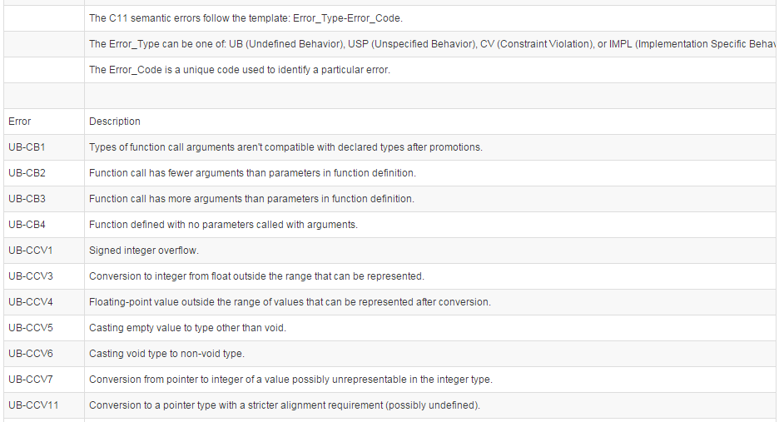
RV-Match Error Reports
…
~200 different error reports

Slide 36
RV-Predict
Predicting Concurrency Errors from Correct Executions without false alarms

Slide 37


RV-Predict Overview
Tomcat (OutputBuffer.java)
Automatically detect the rarest and most difficult data races in your Java/C code, saving on development effort with the most precise race finder available. RV-Predict gives you:
an automatic debugger for subtle Java/C data races with no false positives
seamless integration with unit tests, build infrastructure, and continuous integration
a maximal detection algorithm that finds more races than any sound dynamic tool
…
…
…
…
Conventional testing approaches do not detect the data-race
-------------------------------------------------------
T E S T S
-------------------------------------------------------
Results :
Tests run: 0, Failures: 0, Errors: 0, Skipped: 0
...
...
RV-Predict precisely detects the data-race, and reports the relevant stack-traces
Data race on field java.util.HashMap.$state:
{{{ Concurrent write in thread T83 (locks held: {Monitor@67298f15})
----> at org.apache.catalina.connector.OutputBuffer.clearEncoders(OutputBuffer.java:255)
...
Concurrent read in thread T61 (locks held: {})
----> at org.apache.catalina.connector.OutputBuffer.setConverter(OutputBuffer.java:604) ...

Slide 38
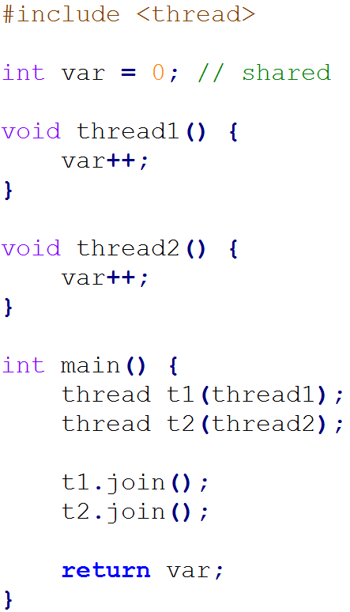
Simple C Data Race Example
What value does it return?
Data race on shared var
This one is easy to spot, but data races can be evil
  Non-deterministic
  Rare
  Hard to reproduce
Led to catastrophic failures
  Human life (Therac 25, Northeastern blackout, …)

Slide 39
Expected Execution
Code
Event Trace
main
1. write(var,0)
2. fork(thread1)
3. fork(thread2)
8. join(thread1)
9. join(thread2)
return(2)
thread1
4. read(var,0)
5. write(var,1)
thread2
6. read(var,1)
7. write(var,2)

Slide 40
UnExpected Execution (Rare)
Code
Event Trace
main
1. write(var,0)
2. fork(thread1)
3. fork(thread2)
8. join(thread1)
9. join(thread2)
return(1)
thread1
4. read(var,0)
6. write(var,1)
thread2
5. read(var,0)
7. write(var,1)

Slide 41
RV-Predict Approach
Instrument program to emit event trace when executed
Give every observed event an order variable
Encode event causal ordering and data race as constraints
Solve constraints with SMT solver
Is ϕ satisfiable?
(we use Z3 solver)
If “yes” then data race
Code
Event Trace
Execute
Build
Model
Analyze
Causal dependence as
mathematical formula ϕ

Slide 42
Predicting Data Races
Code
Assume Expected Execution Trace
main
1. write(var,0)
2. fork(thread1)
3. fork(thread2)
8. join(thread1)
9. join(thread2)
return(2)
thread1
4. read(var,0)
5. write(var,1)
thread2
6. read(var,1)
7. write(var,2)
Causal dependence
Potentialdata race
If ϕ satisfiable then data race is possible
(no false alarm)
Encode causal dependence and data race as constraints:
ϕ = O1<O2<O3<O8<O9 /\ O4<O5 /\ O6<O7
/\ O2<O4 /\ O3<O6 /\ O5<O8 /\ O7<O9
/\ O4=O7 // only one out of 3 races

Slide 43
RV-Predict Features
Program
behaviors
Provably correct and maximal space of causally equivalent paths predicted from one path
Also synchronization, interrupts; see demo
No false alarms: all predicted races are real
Maximal: Impossible to precisely (without false alarms) predict more races than RV-Predict does from the same execution trace
[PLDI’14]
[RV’12]

Slide 44
RV-Predict DEMO
Go to https://runtimeverification.com/predict to download RV-Predict (currently only Java 8 version available); javac and then execute the Java programs under folder examples
  Most of the examples above are also discussed, with detailed comments, at
https://runtimeverification.com/predict/docs/runningexamples
https://runtimeverification.com/blog/?p=58

Slide 45
RV-Monitor
Monitor Safety Requirements and Recover when Violations Detected

Slide 46
RV-Monitor for C
RV-Monitor is a code generator
  Takes safety property specifications as input
  Generates efficient monitoring code library as output
    Provably correct: proof certificate can also be generated
Specifications can be implicit (generic API protocols) or explicit (application-specific)
RV-Monitor specifications consist of
  Events: snapshots of system execution
  Properties: desired sequences of events
  Recovery: what to do when property violated

Slide 47
RV-Monitor Example
Informal requirements
Formal requirements
Safe door lock
Doors should always open only if they were unlocked in the past and not locked since then; at violation, close door.
…(hundreds of these)
∀ d : always (Open(d) implies
not Lock since UnLock)
@violation : Close(d)
Event
Formalize requirements
(by domain experts,
using various formalisms;
here an interval logic)
Automatically
generated
Property
Recovery
Monitor for each d
// One such monitor instance
// in for each door d
State: one bit, b
b = UnLock || !Lock && b
if (Open && !b)
then send(Close)
Provably correct

Slide 48
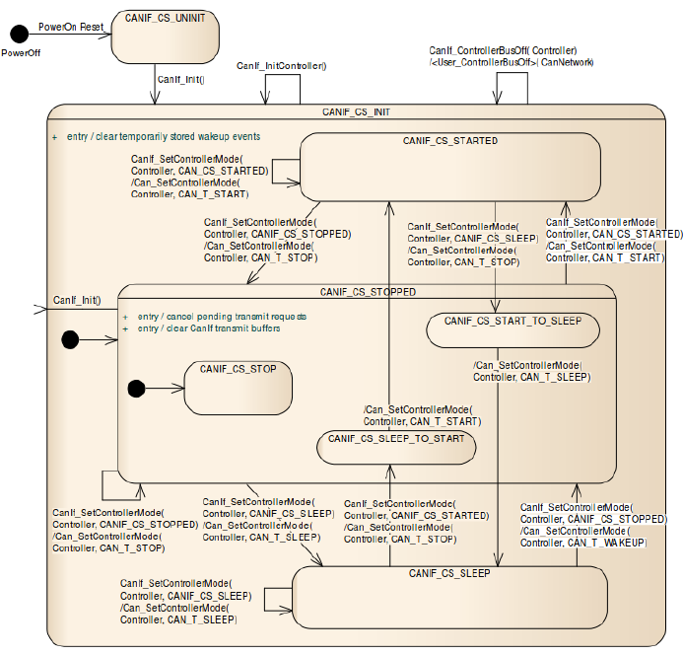
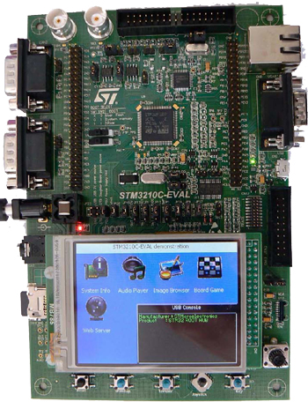
RV-Monitor Applications
RV-AUTOSAR
  Monitor AUTOSAR compliance
  Formalized 20+ CAN interface properties
RV-ECU
  ECU in charge of safety on CAN bus
  Runs LLVM
  All code generated automatically from safety specifications; provably correct
  Built prototype using STM ECU board STM3210C-EVAL
    Currently runs in an actual car (model omitted)

Slide 49
RV-ECU DEMO
Go to https://runtimeverification.com/ecu and watch video

Slide 50
Conclusion
Runtime Verification, Inc., is a new startup company licensed by the University of Illinois
Offers solutions for reliable and safe software
Technology based on runtime verification
  Scalable, rigorous, automatic, no false alarms
  Can also be done exhaustively: full verification
  Leaders in the field
Business model
  General-purpose libraries and tools
  Custom tools and services to select customers

