Slide 1
https://runtimeverification.com
RV-ECU: Certifiable
Runtime Verification
for Automobiles
Grigore Rosu
President and CEO at Runtime Verification, Inc.
Professor of Computer Science at the University of Illinois at Urbana-Champaign

Slide 2
Why Bother?
NSF (Phase I) and NASA (Phase II) SBIR grants
Want to be sure technology is useful before developing it
What you can get from it
Reduce or avoid car recalls
Safety requirements not violated, dynamically updatable
Even if car is hacked (no distinction between hacked or malfunctioning ECU)
Easier compliance to ISO 26262 for safety
Safety monitors generated automatically (provably correct)
Enhanced communication between OEMs and suppliers
Formal safety specifications will be required and shared
Easier, better, faster testing
Separation of major concerns: safety versus functionality

Slide 3
Background
Modern automobiles highly computerized, including dozens of Electronic Control Units (ECUs) communicating over the CAN bus

Slide 4
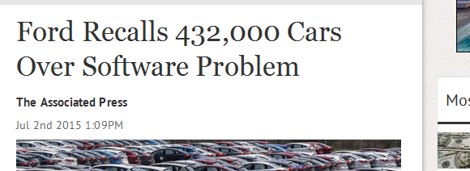
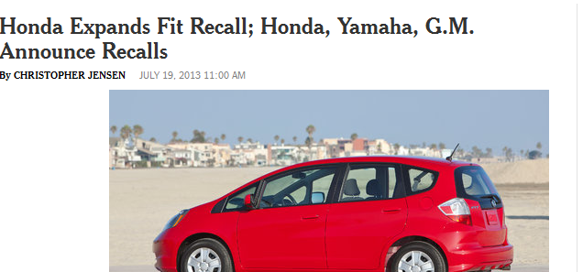
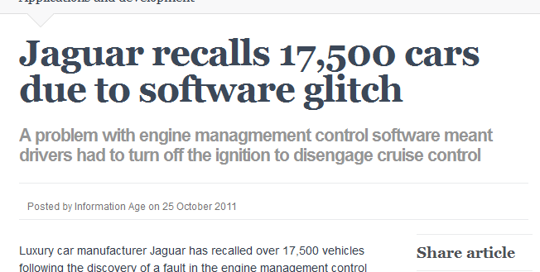
The Importance of Recall
Recall is the most important unsolved problem in automotive
Recalls are costly ($2B+) and bad for business, and software related recalls are (increasingly) common

Slide 5
Software Complexity Trends
More ECUs, more money on electronics, more features, more code
Source: "Automotive Embedded Software Verification and Validation Strategies", Shankar Akella, Emmeskay Advanced Technology Solutions

Slide 6
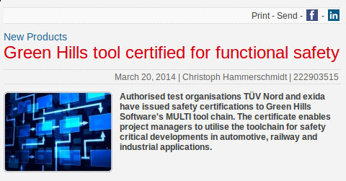
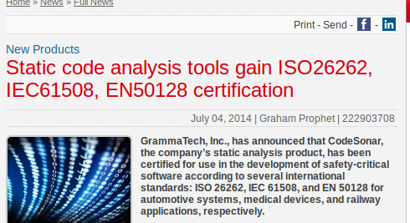
ISO 26262 Reshapes Safety
ISO 26262 changing the face of automotive: first functional safety standard, in response to growing software complexity trends
Both OEMs and suppliers scrambling for compliance

Slide 7
Problem
Current state-of-the-art not ideal
Formal safety requirements not available
OEMs blame suppliers, suppliers blame OEMs
ECUs developed by suppliers; code not available
Poor CAN bus architecture
Any ECU can send messages to any other ECU
ECU sent messages cannot be stopped

Slide 8
Proposal
RV-ECU: in charge of monitoring global safety
Provably correct (both monitoring and recovery code)
ECUs locally monitored
Their critical CAN bus messages “approved” by local monitors
Local monitors communicate with RV-ECU
Local monitors achieved by instrumentation or API
Local
monitors
RV-
Global
monitor

Slide 9
Local vs. Global (RV-ECU) Monitor
ECU
Usual ECU Code
ECU
RV-ECU
Global
monitor
Local
monitor
CAN Bus
All monitoring code (red) generated automatically from safety requirements; recovery code verified
Certifiably correct (checkable proofs also generated)
Local monitors added through instrumentation (automatically) or provided API, and can
Prevent ECU from sending wrong messages
Consult with RV-ECU to assure global safety
Add authentication

Slide 10
Example
Informal requirements
Formal requirements
Safe door lock
Doors should always open only if they were unlocked in the past and not locked since then; at violation, close door.
…(hundreds of these)
∀ d : always (Open(d) implies
not Lock since UnLock)
@violation : Close(d)
Formalize requirements
(by domain experts,
using various formalisms;
here an interval logic)
Automatically
generated
Monitor for each d
// One such monitor instance
// in RV-ECU for each door d
State: one bit, b
b = UnLock || !Lock && b
if (Open && !b)
then send(Close)
Provably correct

Slide 11
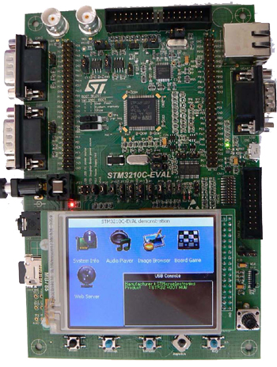
Current RV-ECU Progress
Prototype RV-ECU on an STM ECU
board STM3210C-EVAL
Working on a real car (model omitted)
controlling wipers, windows, doors
soon engine and brakes
For the time being, local monitors intended to be as simple as just requesting acknowledgements for messages to be sent on the bus from RV-ECU
So RV-ECU does all monitoring, but local monitors ensure that safety violating messages are not sent

Slide 12
Wrap Up
Certifiable runtime monitoring code generation
Technology developed at the University of Illinois over a period of more than 12 years, funded with more than $6M by NSF, NASA, DARPA, NSA, Boeing
Product for increasing safety in cars to be developed in our small company with SBIR funding from NSF, NASA, and research collaborations with automotive companies
Main insight: separate safety from functionality and take no chances with safety (use highest assurance known for it!)
Practical impact sought:
Looking for collaboration, partnership, leverage, matching funding (for our NASA and NSF grants)

